Slide 1
webcam controlling and object detection
Guided by: created by:
Mr. kamal soni Sumiran rai

Slide 2
AGENDA
INTRODUCTION
OVERVIEW
FEATURES
HOW IT WORKS
ADVANTAGES
CONCLUSION

Slide 3
INTRODUCTION
Object detection is one of the most basic and central task in computer vision. Its task is to find all the interested objects in the image, and determine the category and location of the objects..
Object detection is widely used and has strong practical value and research prospects.
The main purpose of object detection is to identify and locate one or more effective targets from still image or video data.

Slide 4
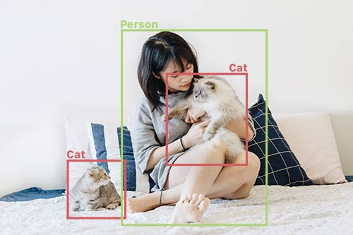

Slide 5
OVERVIEW
It comprehensively includes a variety of important techniques, such as image processing, pattern recognition, artificial intelligence and machine learning.
Image recognition assigns a label to an image.
Object detection draws bounding boxes around these detected objects

Slide 6
FEATURES
It allows us to locate where said objects are in a given scene.
It helps in image processing .
It recognizes the pattern .
Locate the presence of objects with a bounding box and types or classes of the located objects in an image .

Slide 7
HOW IT WORKS
The object detection models typically have two parts.
An encoder tales an image as input and runs it through a series of blocks and layers that learn to extract statistical features used to locate and label objects .
Outputs from the encoder are then passed to a decoder , which predicts bounding
Boxes and labels for each object.

Slide 8
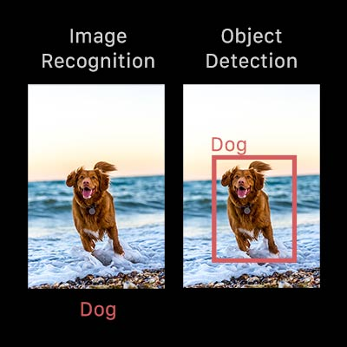

Slide 9
ADVANTAGES
Easy to use
Image Recognition.
Image Segmentation.
Easy operations for the operator of the system.
Helps in understanding and analyze scenes in images.
No paperwork required.

Slide 10

The Button Window of Application

Slide 11
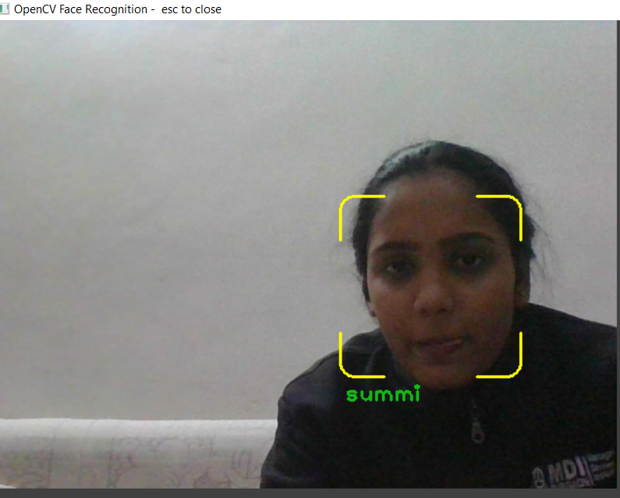
Screen Shot of actual recognition.

Slide 12
CONCLUSION
Object detection is key ability required by most computer and robot vision systems.
The latest research on this area has been making great progress in many directions .
In the current manuscript ,we gave an overview of past research on object detection , outline the current main research directions , and discuss open problems and possible future directions.

Slide 13
THANK YOU!

